Slide 1
Intermediate Code Generation
Unit 5
Dr. Sini Anna Alex

Slide 2
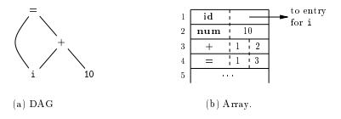
Value Number Method for Constructing DAG’s
Nodes of Syntax Tree or DAG – stored in an array of records.
Each row represents- one record(one node)
Nodes of a DAG for i=i+10

Slide 3
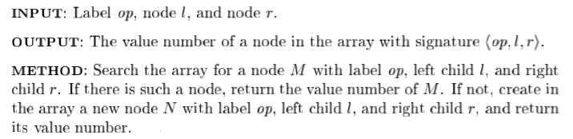
Algorithm: The value-number method for constructing the nodes of a DAG.
Construct three address code and VNM for the given DAG a+b+(a+b)
DAG
Three Address Code
t1= a+ b
t2=t1+t1
Value Number Method (VNM)
+
1
id |  | Entry for a
id |  | Entry for b
+ | 1 | 2
+ | 3 | 3
+
2
a
b
3
4

Slide 4
Three Address Code
In three-address code, there is at most one operator on the right side of an instruction.
source-language expression like x+y*z might be translated into the sequence of three-address instructions
t1 = y * z
t2 = x + t1
where t1 and t2 are compiler-generated temporary names.

Slide 5
Three Address Code From DAG and From Syntax Tree
a+b+(a+b)
Three Address Code
t1=a+b
t2=a+b
t3=t1+t2
DAG
Syntax Tree
+
E
E + T
E + T ( E )
T id E + T
Id T id
id
+
a
b
Three Address Code
t1= a+ b
t2=t1+t1

Slide 6
Addresses and Instructions
Three-address code is built from two concepts: addresses and instructions.
An address can be one of the following:
Name
Constant
A compiler-generated temporary

Slide 7
Common three-address instruction forms
1. Assignment instructions of the form x = y op z, where op is a binary arithmetic or logical operation, and x, y, and z are addresses.
2. Assignments of the form x = op y, where op is a unary operation. Essential unary operations include unary minus, logical negation, and conversion operators, for example, convert an integer to a floating-point number.
3. Copy instructions of the form x = y, where x is assigned the value of y.

Slide 8
Common three-address instruction forms contd..
4. An unconditional jump goto L. The three-address instruction with label L is the next to be executed.
5. Conditional jumps of the form if x goto L and ifFalse x goto L.
6. Conditional jumps such as if x relop y goto L, which apply a relational operator (<, ==, >=, etc.) to x and y, and execute the instruction with label L next if x stands in relation relop to y.

Slide 9
Common three-address instruction forms contd..
7. Procedure calls and returns are implemented using the following instructions: param x for parameters;
call p,n and y = call p,n for procedure and function calls, respectively;
return y, where y, representing a returned value, is optional.
p(x1,x2;…, xn) param x1
param x2
...
param xn
call p,n
Where n= no of arguments
8. Indexed copy instructions of the form x=y[i] and x[i]=y.
9. Address and pointer assignments of the form x =&y, x =*y, and *x = y. The instruction x =&y sets the r-value of x to be the location (l-value) of y.

Slide 10
Three Address Code Translation
a=b[i]+c[j]
2. a[i]=b*c + b*d
3. x=f(y+1)+2

Slide 11
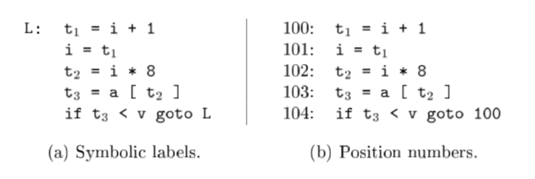
Three address Translation of Control Statements
Consider the statement
do i = i+1; while (a[i] < v);
Two possible translations of this statement are

Slide 12
The description of three-address instructions
Three address instructions can be implemented as objects or as records with fields for the operator and the operands. Three such representations are called quadruples, triples, and indirect triples.
Quadruples- A quadruple (or just quad) has four fields: op, arg1, arg2, and result.
The op field contains an internal code for the operator.
For instance, the three-address instruction x = y +z is represented by placing + in op, y in arg1, z in arg2, and x in result.

Slide 13
Quadruple Representation
The following are some exceptions to this rule:
1. Instructions with unary operators like
x = minus y or x = y do not use arg2. For a copy statement like x = y, op is =, while for most other operations, the assignment operator is implied.
2. Operators like param use neither arg2 nor result.
3. Conditional and unconditional jumps put the target label in result.

Slide 14
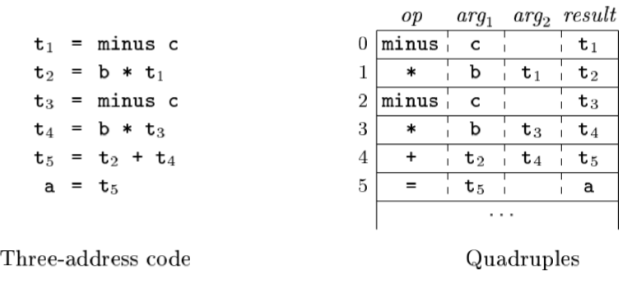
Quadruple representation of a = b*-c + b*-c

Slide 15
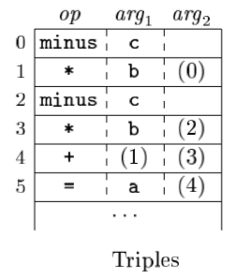
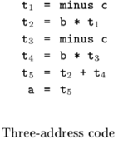
Triples
A triple has only three fields, which we call op, arg1, and arg2. With triples, the result of an operation is referred to by its position, so moving an instruction may require us to change all references to that result.
Triple Representation of a = b*-c + b*-c

Slide 16
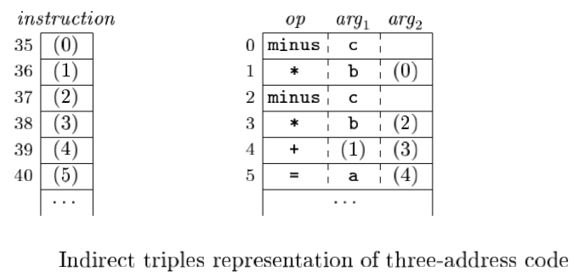
Indirect Triples
Indirect triples consist of a listing of pointers to triples, rather than a listing of triples themselves. With indirect triples, an optimizing compiler can move an instruction by reordering the instruction list, without a directing the triples themselves

Slide 17
THANK YOU

